Slide 1
Outlier
Wind Speed
Max PAR
CO2

Slide 10
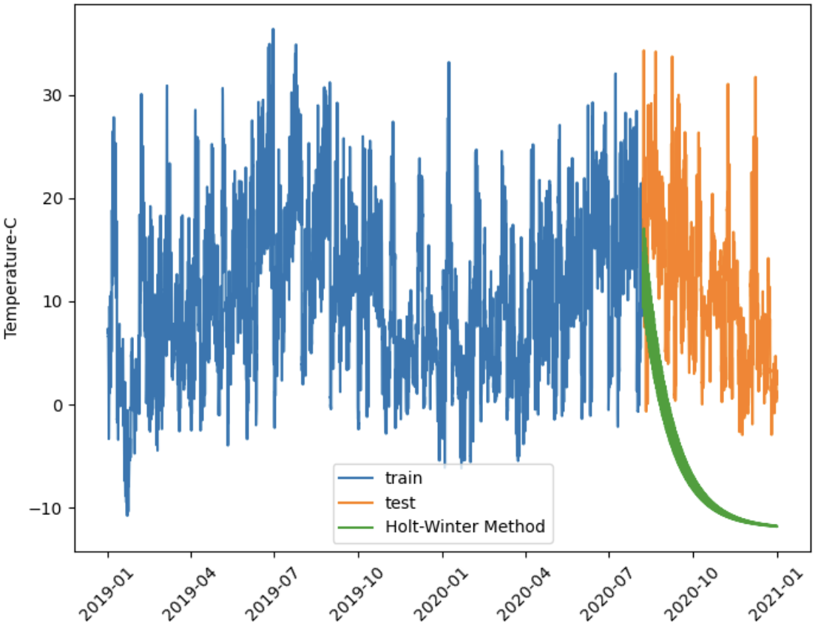
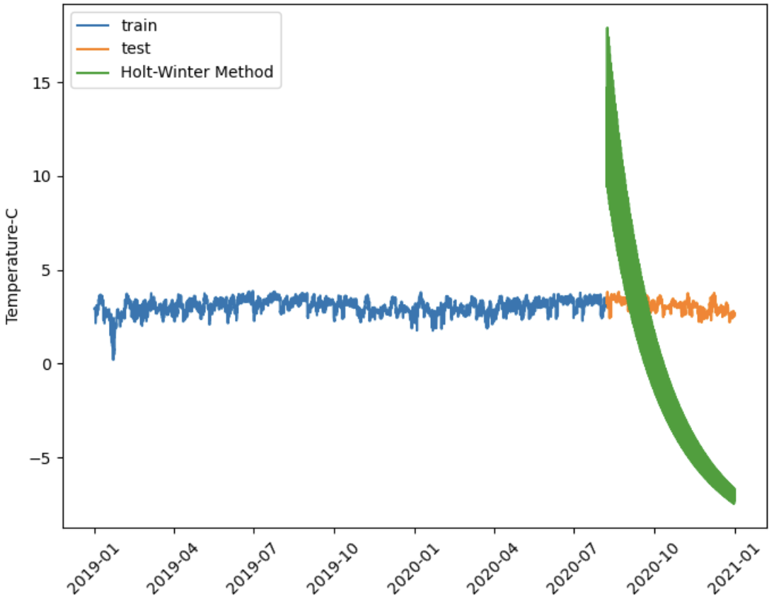
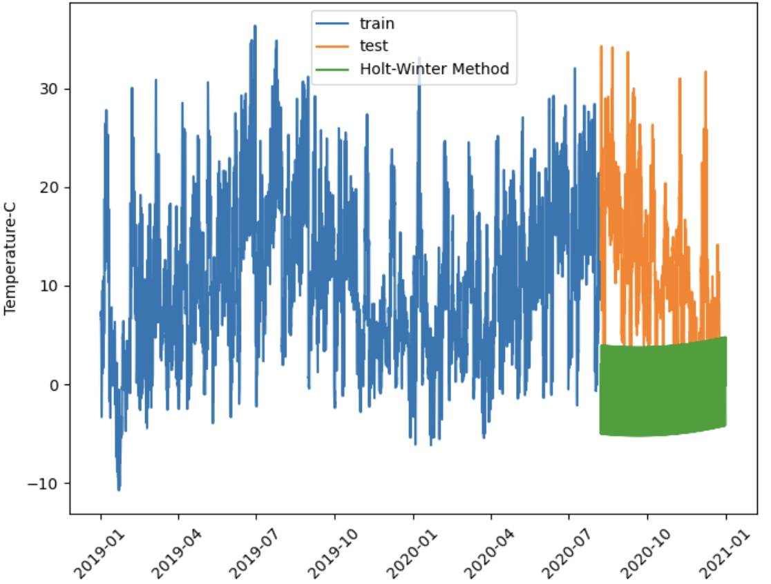
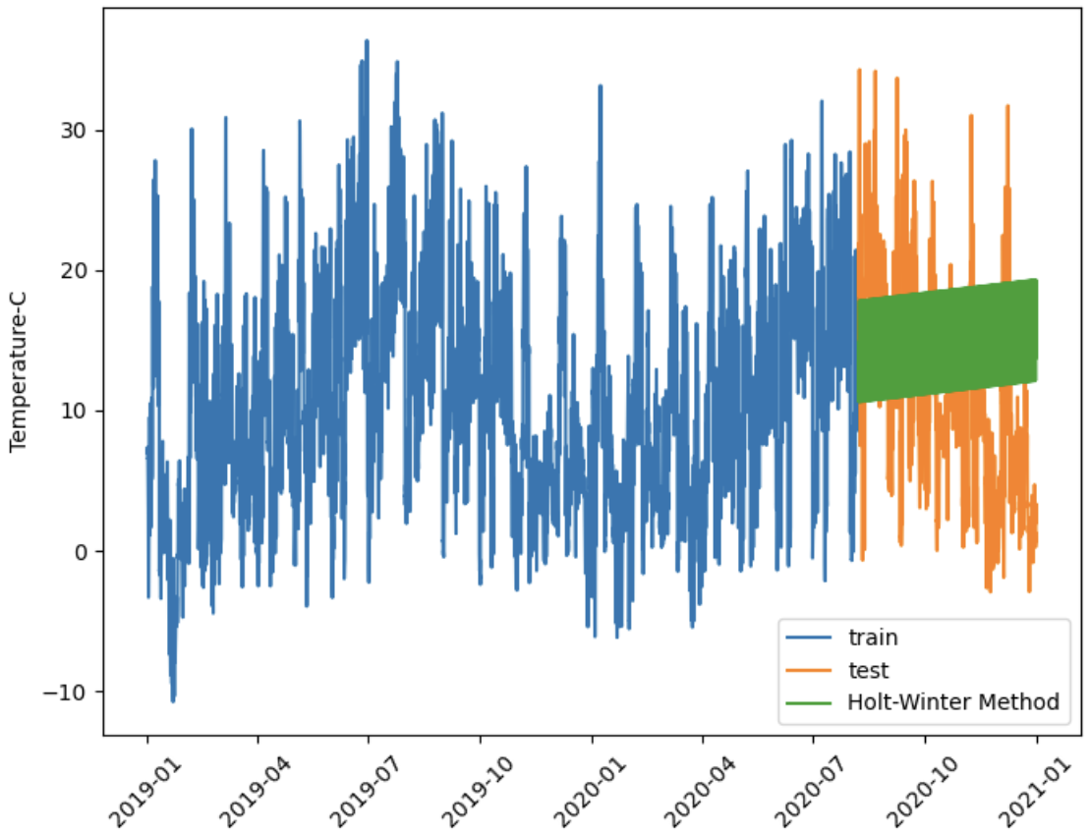
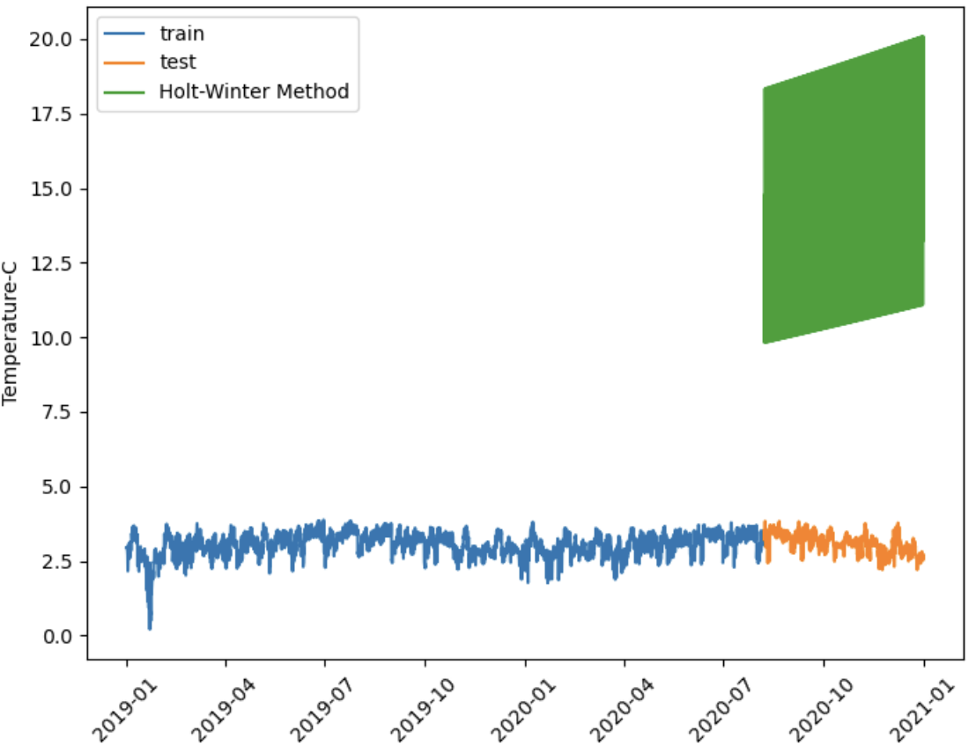
Raw(Mul)
Log(Mul)
1st diff (Add)
Raw(Add)
Log(Add)

Slide 11
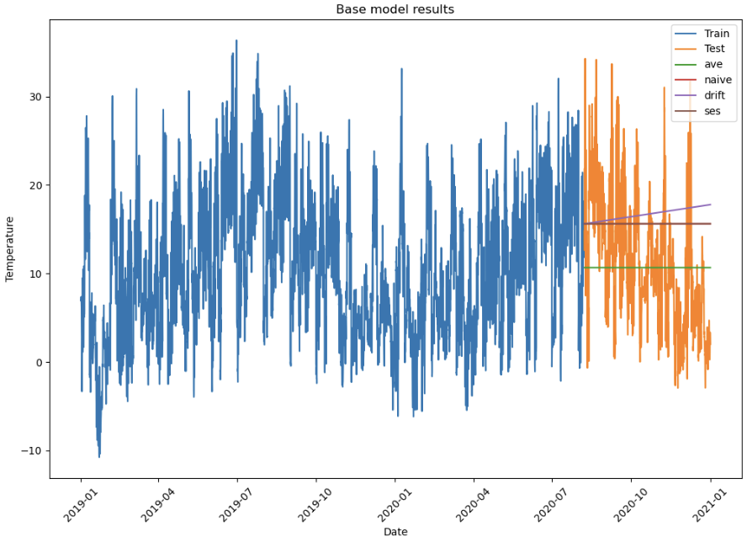

Slide 12
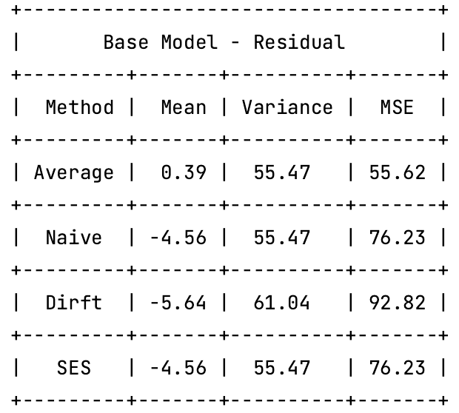

Slide 13
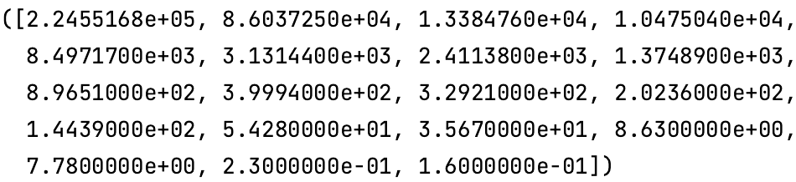
Singular values:
Condition number:
1,409,780.69

Slide 14
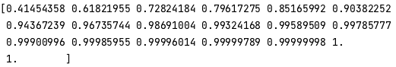
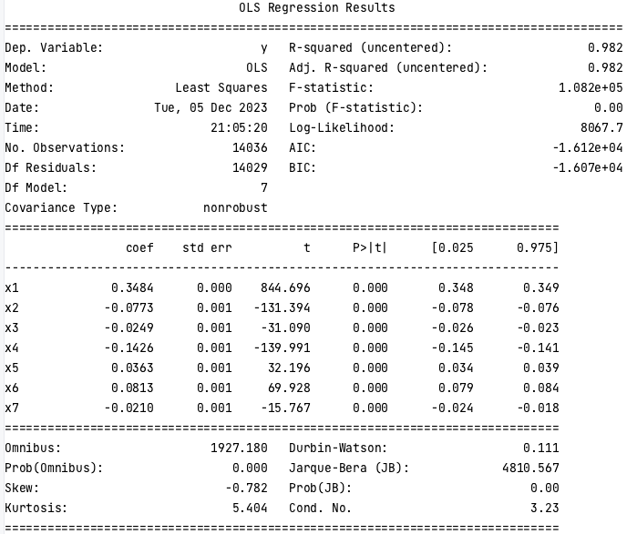
PCA

Slide 17
Remove | p-value | AIC | BIC | Adj_R2
\ | \ | (99,209.90) | (99,058.90) | 1.00
PAR | 0.79 | (99,211.90) | (99,068.40) | 1.00
Vapor_p_max | 0.33 | (99,212.90) | (99,077.00) | 1.00
CO2 | 0.09 | (99,212.00) | (99,083.60) | 1.00

Slide 18
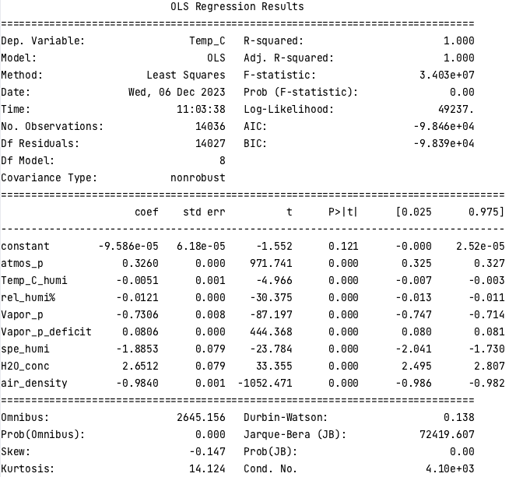
Backward stepwise regression

Slide 21
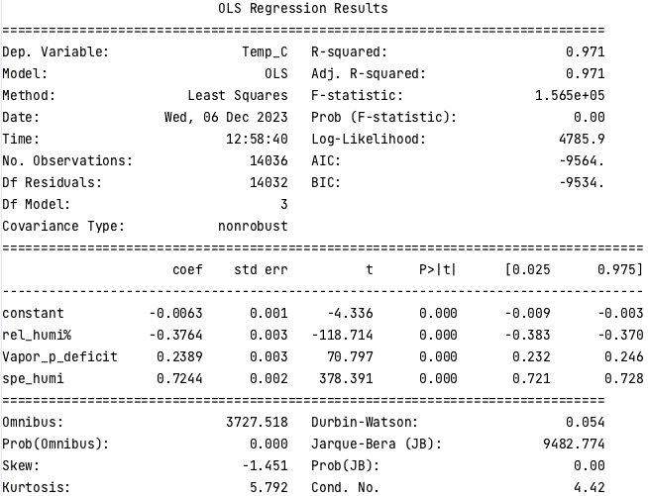
VIF

Slide 24
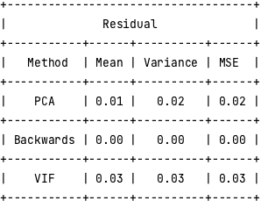

Slide 25
Raw
AR=1, MA=0

Slide 26
2 non-seasonal diff + 1 seasonal diff
MA = 1, AR = 0

Slide 27
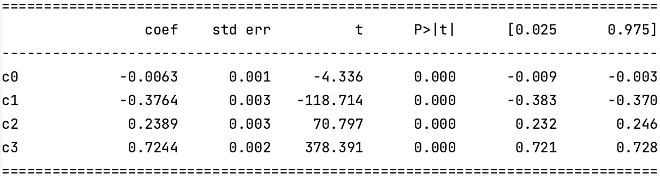
T-test
F-test

